Slide 1
Flow of control (Chapter 3)
  The if-else stetement
  The Type boolean
  The switch statement
Notes:
An individual’s data is connected to enormous data from people over the world such as social network, research articles, and biomedical data on daily basis via internet.

Slide 2
Flow of control
Flow of control is the order in which a program performs actions.
    Up to this point, the order has been sequential.
A branching statement chooses between two or more possible actions.
A loop statement repeats an action until a stopping condition occurs.

Slide 3
The if-else Statement: Outline
Basic if-else Statement
Boolean Expressions
Comparing Strings
Nested if-else Statements
Multi-branch if-else Statements
The switch Statement

Slide 4
The if-else Statement
A branching statement that chooses between two possible actions.
Syntax
    if (Boolean_Expression)
    Statement_1
    else
    Statement_2

Slide 5
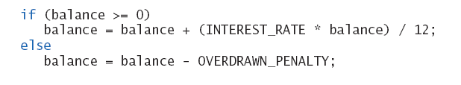
The if-else Statement: example

Slide 6
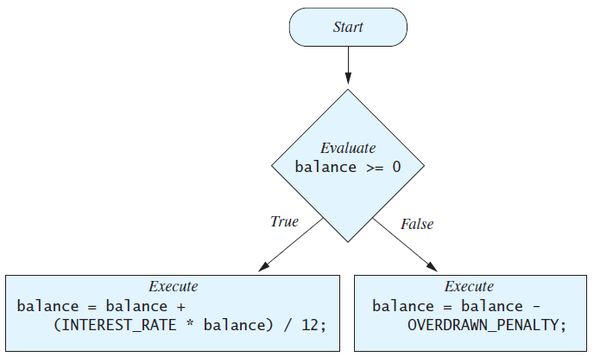
The if-else Statement
The Action of the if-else Statement

Slide 7
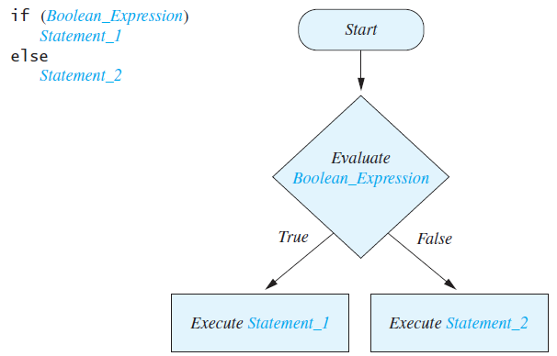
The semantics of the if-else Statement

Slide 8
Compound Statements
To include multiple statements in a branch, enclose the statements in braces.
  if (count < 3)
  {
  total = 0;
  count = 0;
  }

Slide 9
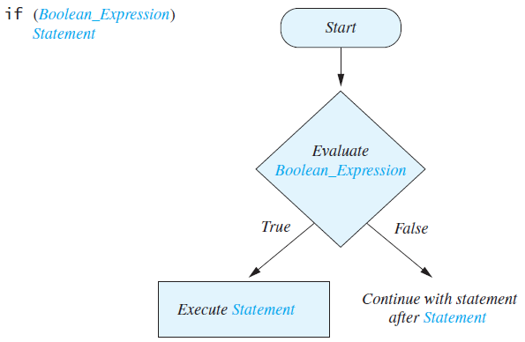
Omitting the else Part
The Semantics of an if Statement without an else

Slide 10
Introduction to Boolean Expressions
The value of a boolean expression is either true or false.
Examples
    time < limit
    balance <= 0

Slide 11
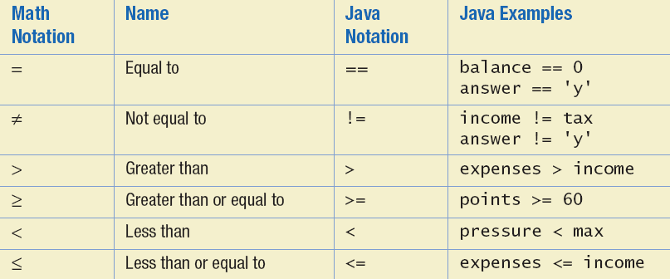
Java Comparison Operators

Slide 12
Compound Boolean Expressions
Boolean expressions can be combined using the "and" (&&) operator.
Example
    if ((score > 0) && (score <= 100))
    ...
Not allowed
    if (0 < score <= 100)
    ...

Slide 13
Compound Boolean Expressions
Syntax
    (Sub_Expression_1) && (Sub_Expression_2)
Parentheses often are used to enhance readability.
The larger expression is true only when both of the smaller expressions are true.

Slide 14
Compound Boolean Expressions
Boolean expressions can be combined using the "or" (||) operator (둘 중 하나 혹은 둘다 참이면 참)
Example
    if ((quantity > 5) || (cost < 10))
    ...
Syntax
    (Sub_Expression_1) || (Sub_Expression_2)

Slide 15
Negating a Boolean Expression
A boolean expression can be negated using the "not" (!) operator.
Syntax
    !(Boolean_Expression)
Example
    (a || b) && !(a && b)
  which is the exclusive or

Slide 16
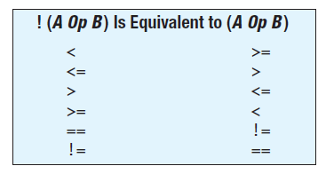
Negating a Boolean Expression
Avoiding the Negation Operator

Slide 17
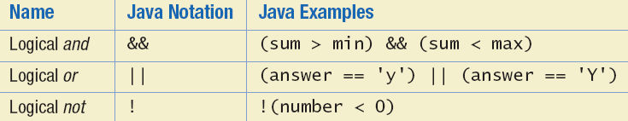
Java Logical Operators

Slide 18
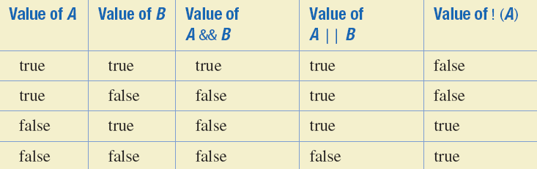
Boolean Operators
The Effect of the Boolean Operators && (and), || (or), and ! (not) on Boolean values

Slide 19
Using ==
== is appropriate for determining if two integers or characters have the same value.
    if (a == 3)
    where a is an integer type
== is not appropriate for determining if two floating points values are equal. Use < and some appropriate tolerance instead.
    if (abs(b - c) < epsilon)
    where b, c, and epsilon are floating point types

Slide 20
Using ==
== is not appropriate for determining if two objects have the same value.
    if (s1 == s2), where s1 and s2 refer to strings, determines only if s1 and s2 refer the a common memory location.
    If s1 and s2 refer to strings with identical sequences of characters, but stored in different memory locations, (s1 == s2) is false.

Slide 21
Using ==
To test the equality of objects of class String, use method equals.
    s1.equals(s2)
    or
    s2.equals(s1)
  To test for equality ignoring case, use method equalsIgnoreCase.
    ("Hello".equalsIgnoreCase("hello"))

Slide 22
equals and equalsIgnoreCase
Syntax
  String.equals(Other_String)
  String.equalsIgnoreCase(Other_String)

Slide 23
Lexicographic Order
Lexicographic order is similar to alphabetical order, but is it based on the order of the characters in the ASCII (and Unicode) character set.
    All the digits come before all the letters.
    All the uppercase letters come before all the lower case letters.

Slide 24
Lexicographic Order
Strings consisting of alphabetical characters can be compared using method compareTo and method toUpperCase or method toLowerCase.
    String s1 = "Hello";
    String lowerS1 = s1.toLowerCase();
    String s2 = "hello";
    if (s1.compareTo(s2)) == 0
    System.out.println("Equal!");

Slide 25
Method compareTo
Syntax
    String_1.compareTo(String_2)
Method compareTo returns
    a negative number if String_1 precedes String_2
    zero if the two strings are equal
    a positive number of String_2 precedes String_1.

Slide 26
Nested if-else Statements
An if-else statement can contain any sort of statement within it.
In particular, it can contain another if-else statement.
    An if-else may be nested within the "if" part.
    An if-else may be nested within the "else" part.
    An if-else may be nested within both parts.

Slide 27
Nested Statements
Syntax
    if (Boolean_Expression_1)
    if (Boolean_Expression_2)
    Statement_1)
    else
    Statement_2)
    else
    if (Boolean_Expression_3)
    Statement_3)
    else
    Statement_4);

Slide 28
Nested Statements
Each else is paired with the nearest unmatched if.
If used properly, indentation communicates which if goes with which else.
Braces can be used like parentheses to group statements.

Slide 29
Compound Statements
When a list of statements is enclosed in braces ({}), they form a single compound statement.
Syntax
    {
    Statement_1;
    Statement_2;
    …
    }

Slide 30
Compound Statements
A compound statement can be used wherever a statement can be used.
Example
    if (total > 10)
    {
    sum = sum + total;
    total = 0;
    }

Slide 31
Multibranch if-else Statements
Syntax
    if (Boolean_Expression_1)
    Statement_1
    else if (Boolean_Expression_2)
    Statement_2
    else if (Boolean_Expression_3)
    Statement_3
    else if …
    else
    Default_Statement

Slide 32
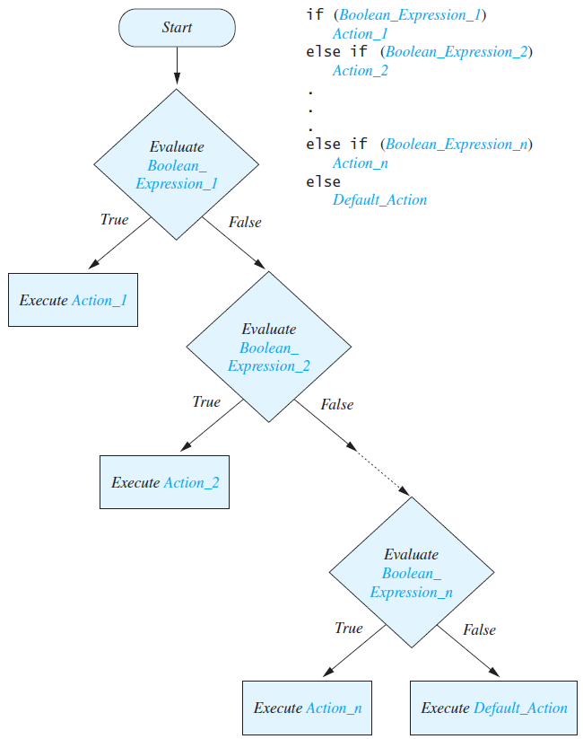
Multibranch if-else Statements

Slide 33
Multibranch if-else Statements
if (score >= 90)
grade = 'A';
else if ((score >= 80) && (score < 90))
grade = 'B';
else if ((score >= 70) && (score < 80))
grade = 'C';
else if ((score >= 60) && (score < 70))
grade = 'D';
else
grade = 'F';

Slide 34
The Conditional Operator
if (n1 > n2)
  max = n1;
  else
  max = n2;
  can be written as
  max = (n1 > n2) ? n1 : n2;
The ? and : together are call the conditional operator or ternary operator.

Slide 35
The Conditional Operator
The conditional operator is useful with print and println statements.
    System.out.print("You worked " +
    ((hours > 1) ? "hours" ; "hour"));

Slide 36
The exit Method
Sometimes a situation arises that makes continuing the program pointless.
A program can be terminated normally by
    System.exit(0);

Slide 37
The exit Method
  if (numberOfWinners == 0)
  {
  System.out.println ("Error: Dividing by zero.");
  System.exit (0);
  }
  else
  {
  oneShare = payoff / numberOfWinners;
  System.out.println ("Each winner will receive $" + oneShare);
  }

Slide 38
The Type boolean
The type boolean is a primitive type with only two values: true and false.
Boolean variables can make programs more readable.
    if (systemsAreOK)
    instead of
    if((temperature <= 100) && (thrust >= 12000) && (cabinPressure > 30) && …)

Slide 39
Boolean Expressions and Variables
Variables, constants, and expressions of type boolean all evaluate to either true or false.
A boolean variable can be given the value of a boolean expression by using an assignment operator.
    boolean isPositive = (number > 0);
    ...
    if (isPositive) ...

Slide 40
Precedence Rules
Parentheses should be used to indicate the order of operations.
When parentheses are omitted, the order of operation is determined by precedence rules.

Slide 41
Precedence Rules
Operations with higher precedence are performed before operations with lower precedence.
Operations with equal precedence are done left-to-right (except for unary operations which are done right-to-left).

Slide 42
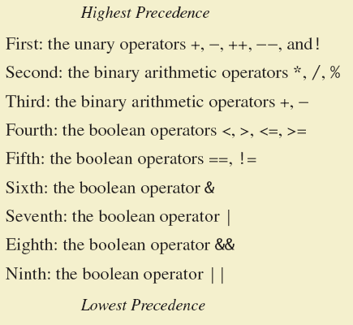
Precedence Rules

Slide 43
Precedence Rules
In what order are the operations performed?
  score < min/2 - 10 || score > 90
  score < (min/2) - 10 || score > 90
  score < ((min/2) - 10) || score > 90
  (score < ((min/2) - 10)) || score > 90
  (score < ((min/2) - 10)) || (score > 90)

Slide 44
Input and Output of Boolean Values
  boolean booleanVar = false;
  System.out.println(booleanVar);
  System.out.println("Enter a boolean value:");
  Scanner keyboard = new Scanner(System.in);
  booleanVar = keyboard.nextBoolean();
  System.out.println("You entered " + booleanVar);

Slide 45
Input Validation
Address these problems by ensuring that the entered values are reasonable:
int feet = keyboard.nextInt();
if ((feet >= 0) && (feet < 10))
{
int inches = feet * 12;
...
}

Slide 46
The switch Statement
The switch statement is a multi-way branch that makes a decision based on an integral (integer or character) expression.
The switch statement begins with the keyword switch followed by an integral expression in parentheses and called the controlling expression.

Slide 47
The switch Statement
A list of cases follows, enclosed in braces.
Each case consists of the keyword case followed by
    A constant called the case label
    A colon
    A list of statements.
The list is searched for a case label matching the controlling expression.

Slide 48
The switch Statement
  switch (Controlling_Expression)
  {
  case Case_Label:
  Statement(s);
  break;
  case Case_Label:
  …
  default:
  …
  }

Slide 49
Enumerations
Consider a need to restrict contents of a variable to certain values
An enumeration lists the values a variable can have
Example
enum MovieRating {E, A, B}
MovieRating rating;
rating = MovieRating.A;

Slide 50
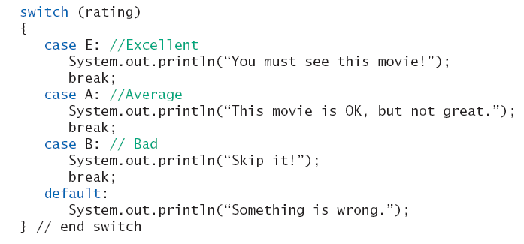
Enumerations
Now possible to use in a switch statement

Slide 51
Enumerations
An even better choice of descriptive identifiers for the constants
enum MovieRating
{EXCELLENT, AVERAGE, BAD}
rating = MovieRating.AVERAGE;
case EXCELLENT: ...

